Slide 1
Control Statements
By
Sana Mateen

Slide 2
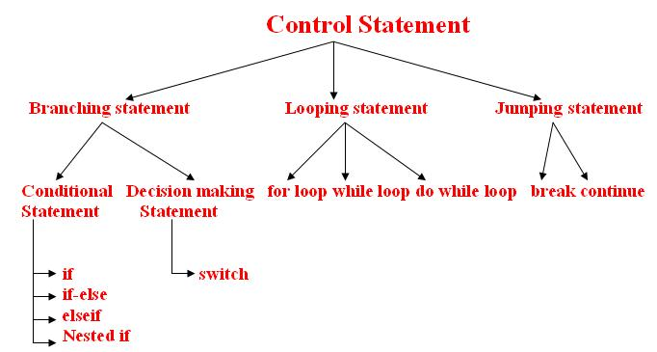

Slide 3
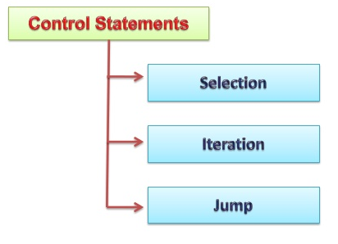
A programming language uses control statements to cause the flow of execution to advance and branch based on changes to the state of a program.
Branching/Selection Statements:
allow your program to choose different paths of execution based upon the outcome of an expression or the state of a variable
Looping/Iteration statements enable program execution to repeat one or more statements (that is, iteration statements form loops).
Jump statements
allow your program to execute in a nonlinear fashion.

Slide 4
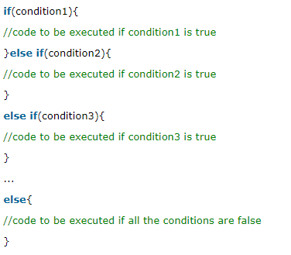

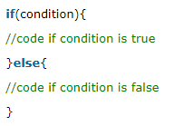
Java If-else Statement
The Java if statement is used to test the condition. It checks boolean condition: true or false. There are various types of if statement in java.
if statement
if-else statement
nested if statement
if-else-if ladder

Slide 5
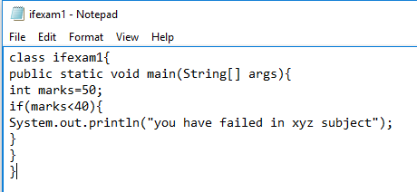
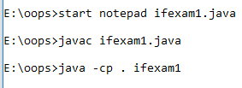
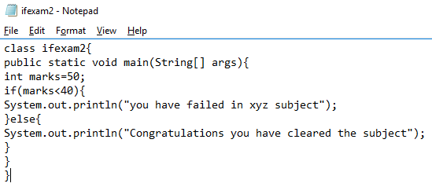
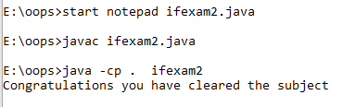

Slide 6
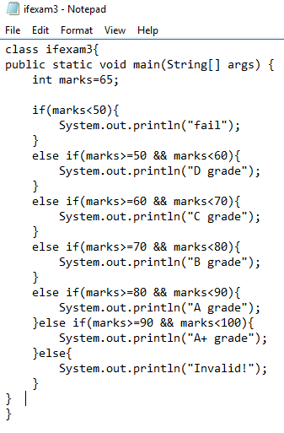
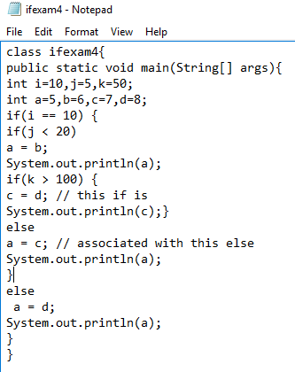
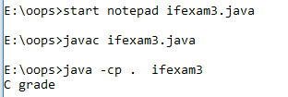
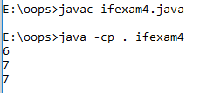

Slide 7
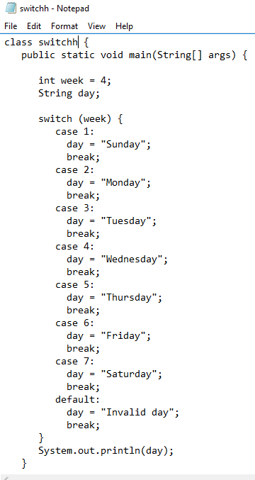
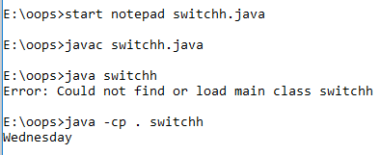

Slide 8
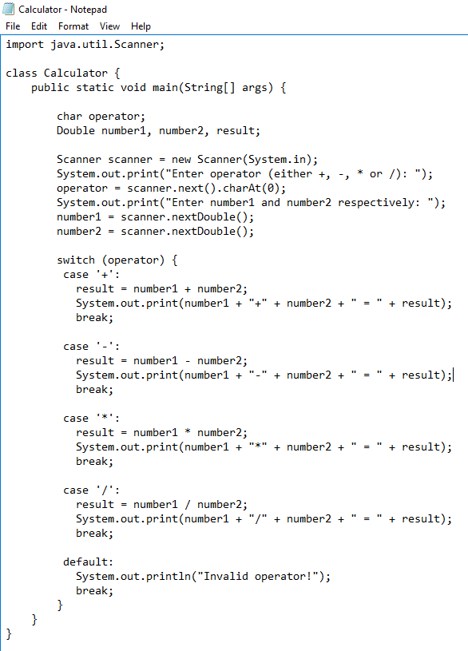
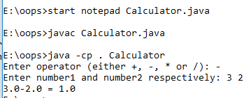

Slide 9
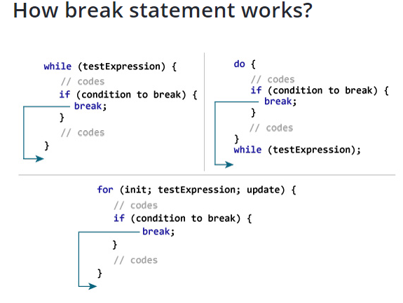
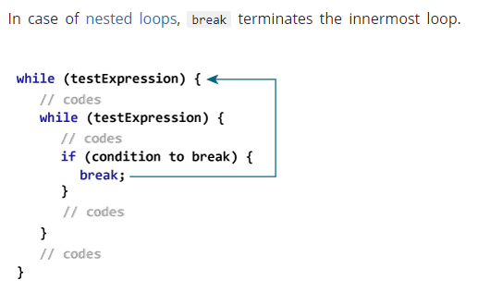
The break statement terminates the loop immediately, and the control of the program moves to the next statement following the loop.

Slide 10
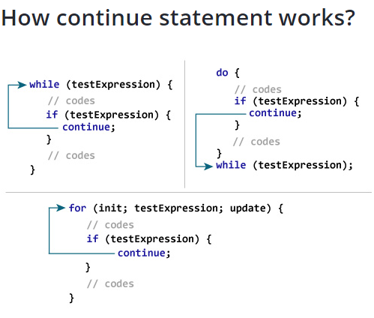
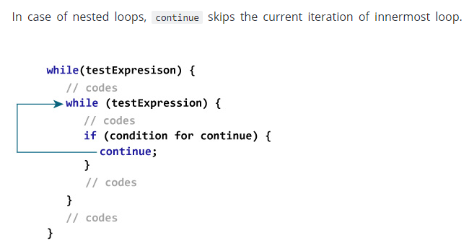
The continue statement skips the current iteration of a loop (for, while, and do...while loop).
When continue statement is executed, control of the program jumps to the end of the loop. Then, the test expression that controls the loop is evaluated. In case of for loop, the update statement is executed before the test expression is evaluated.

Slide 11






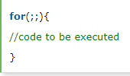
Looping Statements
Loop is used in programming to repeat a specific block of code until certain condition is met (test expression is false).
Loops are what makes computers interesting machines. Imagine you need to print a sentence 50 times on your screen. Well, you can do it by using print statement 50 times (without using loops). How about you need to print a sentence one million times? You need to use loops.

Slide 12
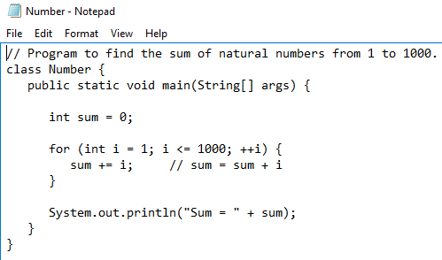
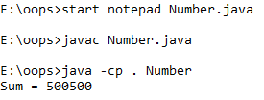
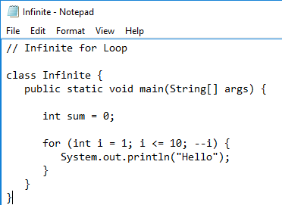
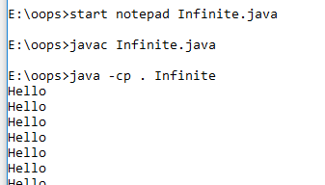

Slide 13
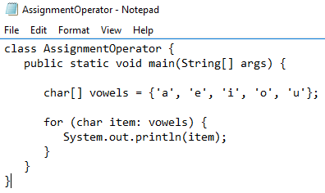
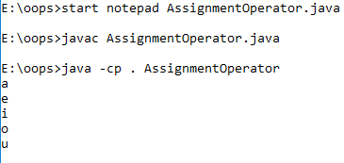
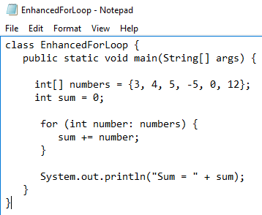
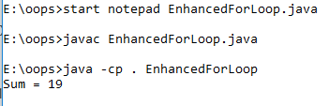

Slide 14
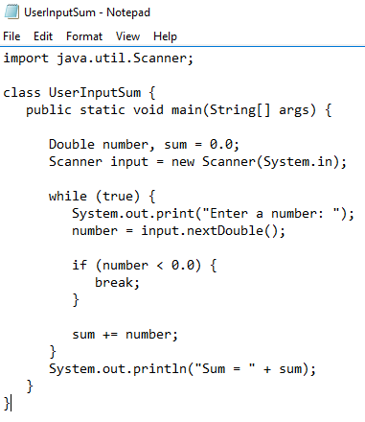
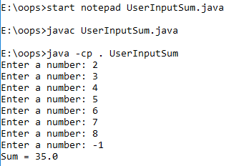

Slide 15
